Slide 1
Beans in Spring
Module 15

Slide 2
Content
Define a bean
Scopes of beans
XML based configuration
Java Based Configuration

Slide 3
Define a bean
An instance / object, instantiated and managed by the IoC container
Each bean has its own configuration which parts are
Way of bean creation
Name/identifier
Scope
Pre initialization and post destroy methods
Lifecycle of the bean
The lifecycle of the bean between bean’s initialization and destroying
Beans dependencies
Other beans dependencies needs to be injected / auto wired by the IoC container

Slide 4
Beans scope
Singleton
Only one instance (bean) of the class per IoC Container
All calls to the bean are made against one and same instance
Prototype
New instance every time a request to that specific bean is made
Request
Accessible only in HTTP thread based application / web-aware IoC Container
One instance of the bean per HTTP request
Session
Accessible only in HTTP thread based application / web-aware IoC Container
One instance of the bean per HTTP session
Global-Session
Accessible only in HTTP thread based application / web-aware IoC Container
One instance of global HTTP session

Slide 5
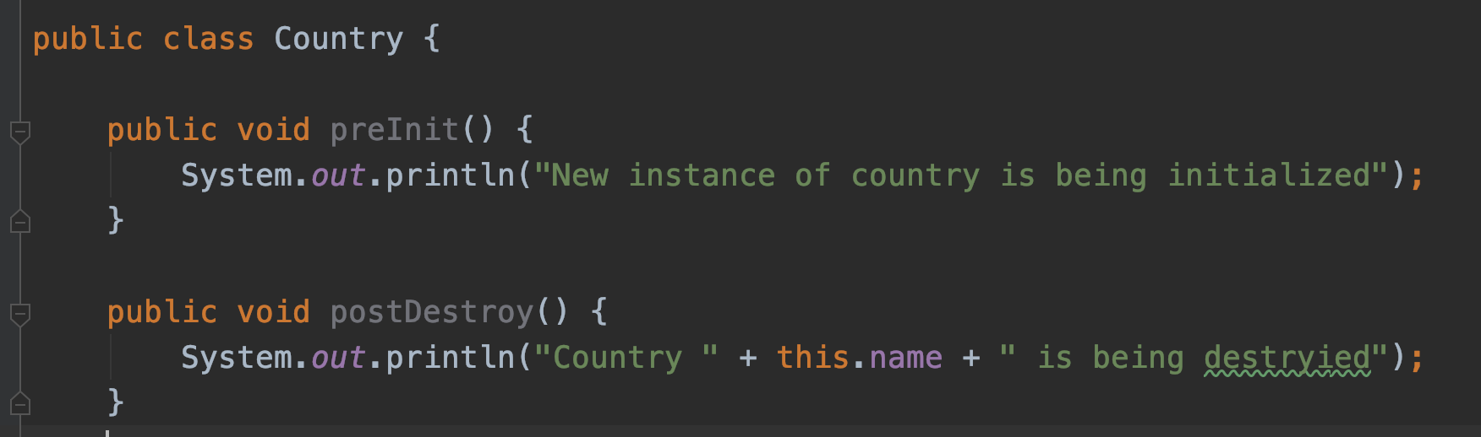
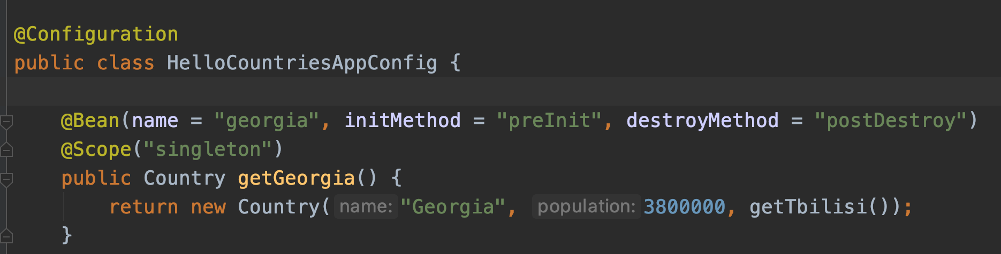
Beans scope

Slide 6
Demo

Slide 7
XML based configuration
Beans defined via xml file
The context called via the ClassPathXmlApplicationContext interface
E.g. ApplicationContext context = new ClassPathXmlApplicationContext(”app.xml");
Example xml file
<?xml version = "1.0" encoding = "UTF-8"?>
<beans xmlns = "http://www.springframework.org/schema/beans" xmlns:xsi = "http://www.w3.org/2001/XMLSchema-instance" xsi:schemaLocation = "http://www.springframework.org/schema/beans http://www.springframework.org/schema/beans/spring-beans-3.0.xsd">
<bean id = "tbilisi" class = "bg.newhorizons.hellocountries.City">
<constructor-arg index="0" value=”Tbilisi "/>
</bean>
</beans>

Slide 8
Java Based Configuration
No required of xml file
Context called via final ApplicationContext context = new AnnotationConfigApplicationContext(AllConfig.class);
Beans are configured via Java and. Simple annotations like @Configuration and @Bean
@Configuration public class AllConfig {
@Bean(name = "tbilisi") public City getTbilisi() { return new City("Tbilisi"); }
}

Slide 9
Questions?
Notes:
Do you have any questions?

Slide 10
Thank You For Your Time

